Slide 1
E-retail factors for customer activation and retention
-Aneesha B Soman

Slide 2
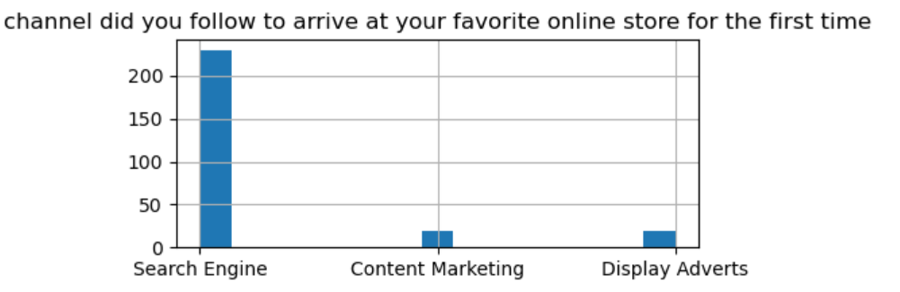
Methods used by respondent during customer activation
Search engine has been the primary usage during the first attempt to reach site

Slide 3
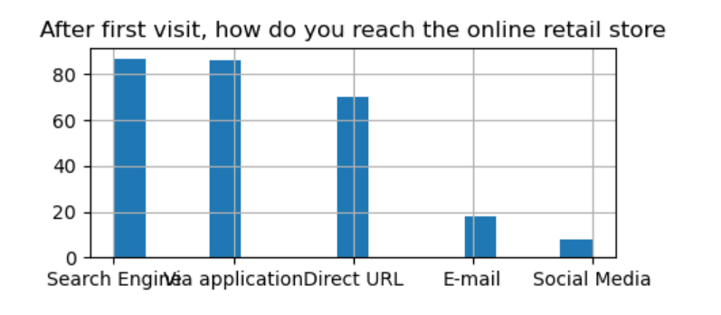
Method used by customer in 2nd time(Customer Retention)
In the second time, the method has search engines usage but also an equal usage of Via application

Slide 4
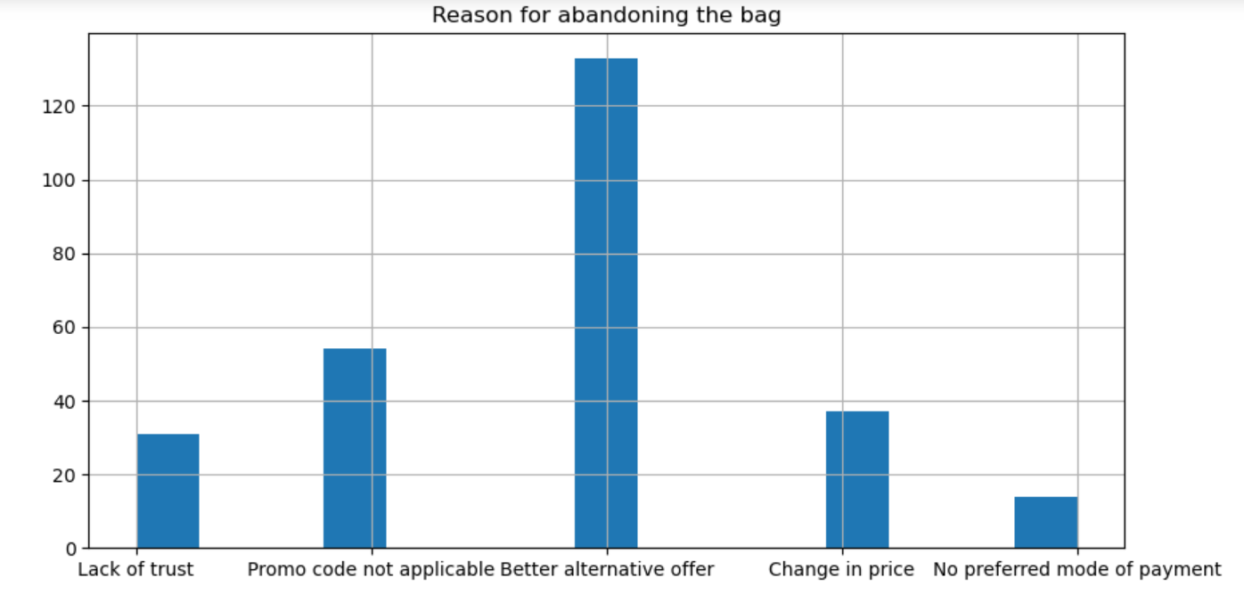

Factors hindering the customer activation
Maximum people and the highest frequency of dropping the bag is because of Better alternative

Slide 5
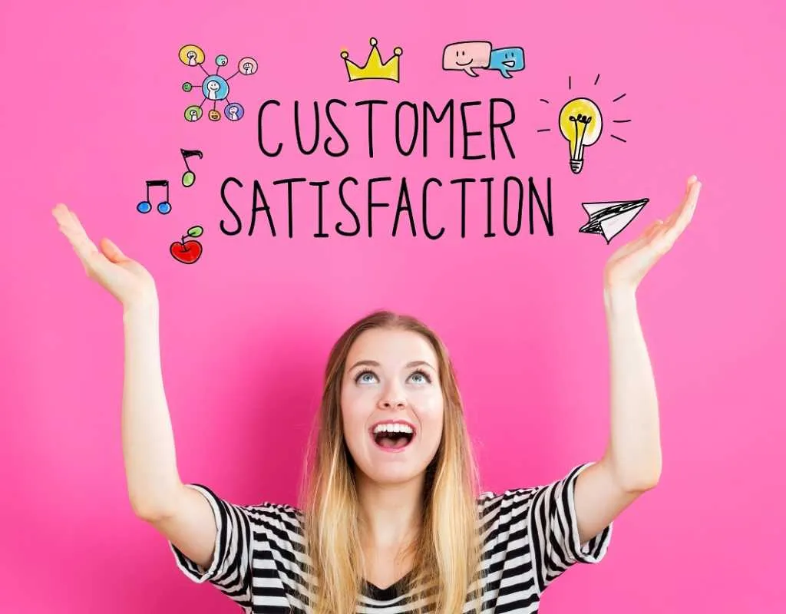

If customer satisfaction increases
Then success of store increases

Slide 6
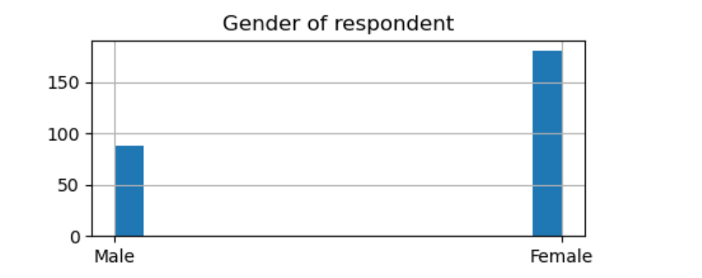
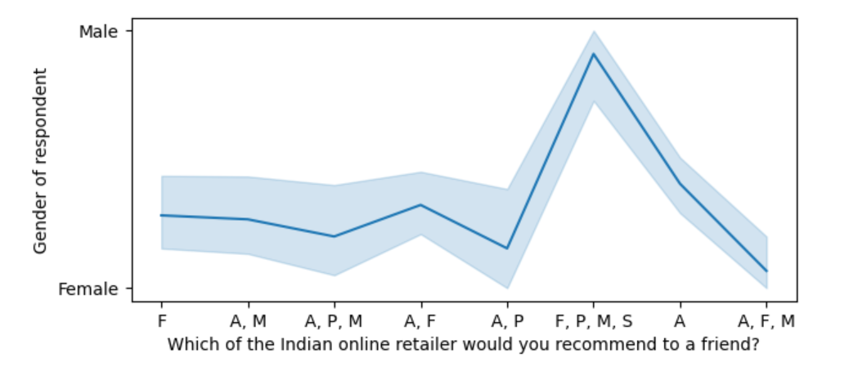
Respondents
More number of female respondents.They consists 3/4th
Male have chosen all flipkart,myntra,snaodeal and paytm but not amazon
Whereas women have chosen all ranges

Slide 7
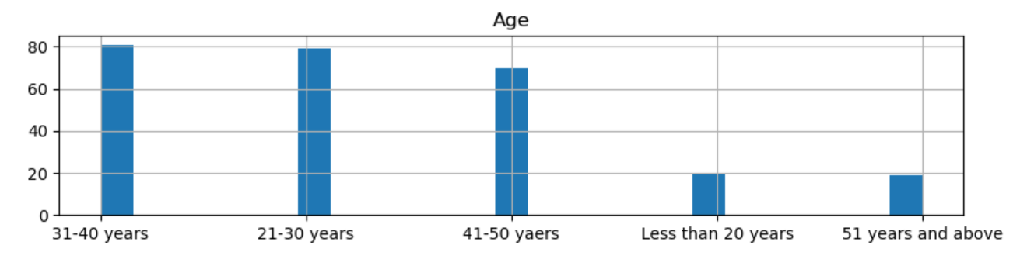
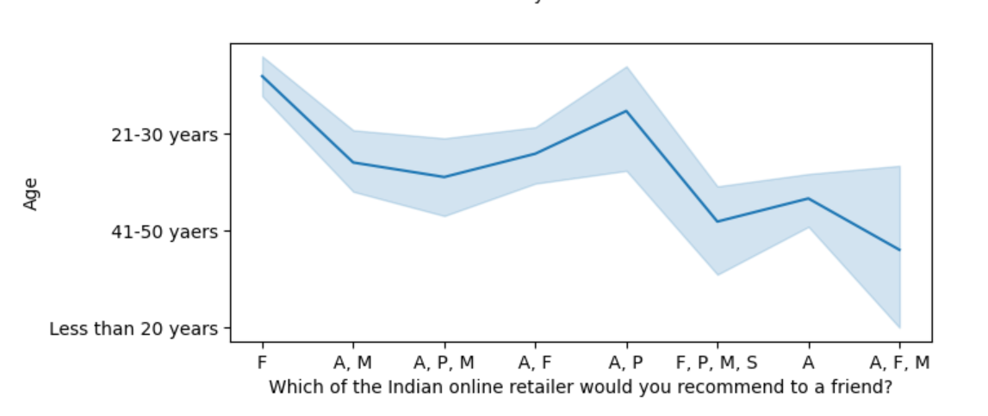
Age
The respondents have been mostly been between 21-50years
21-30years have not chosen snapdeal
41-50years like all of them

Slide 8
Five major factors that contributed to the success of an e-commerce store have been identified as:
system quality
information quality
service quality
trust
Net benefit

Slide 9
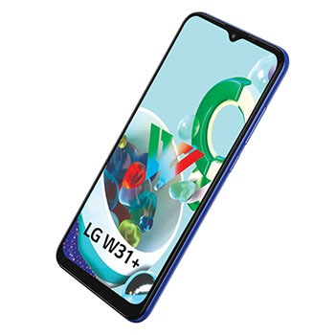
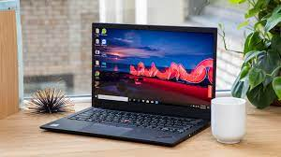
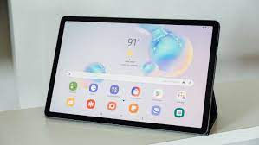
The system quality

Slide 10
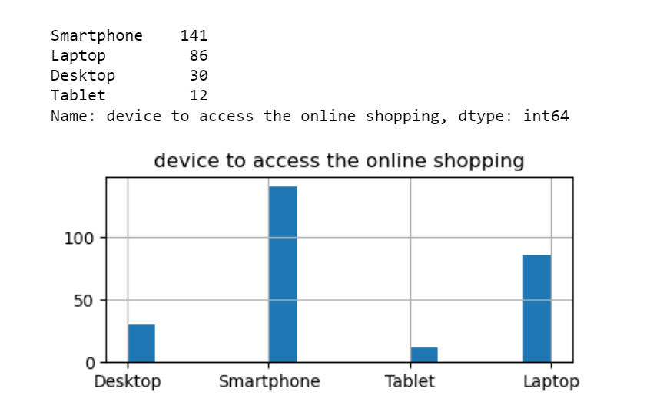

The system quality
Largest number of online shopping done through Smartphone and least through tablet

Slide 11
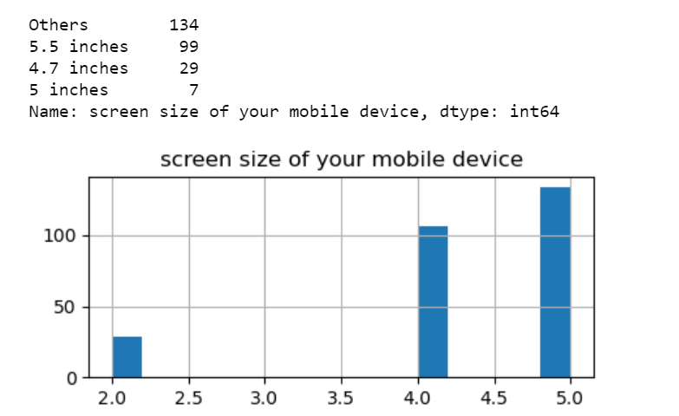
Others is highest with 134 respondents for the device size

Slide 12
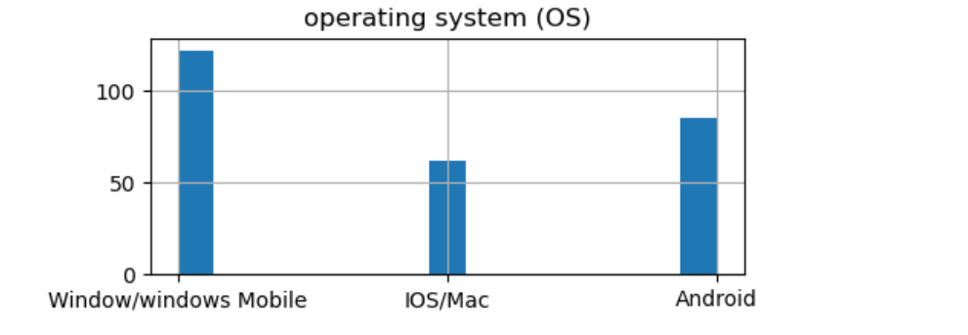

Maximum OS used are Windows

Slide 13
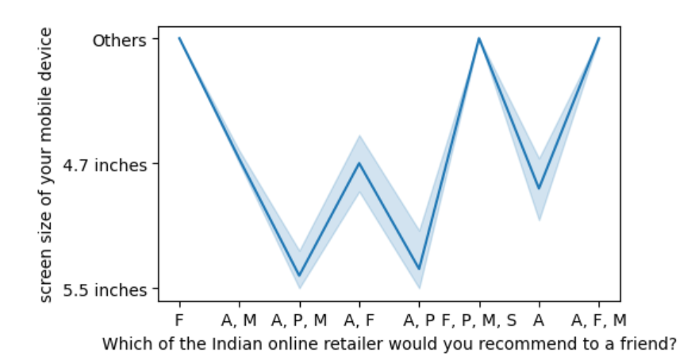
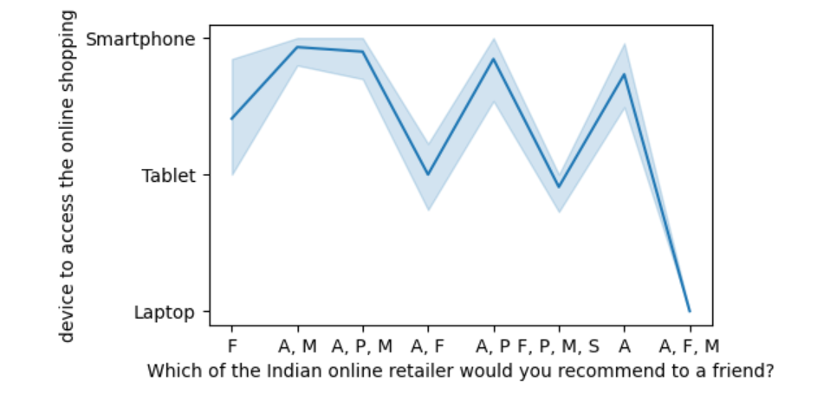
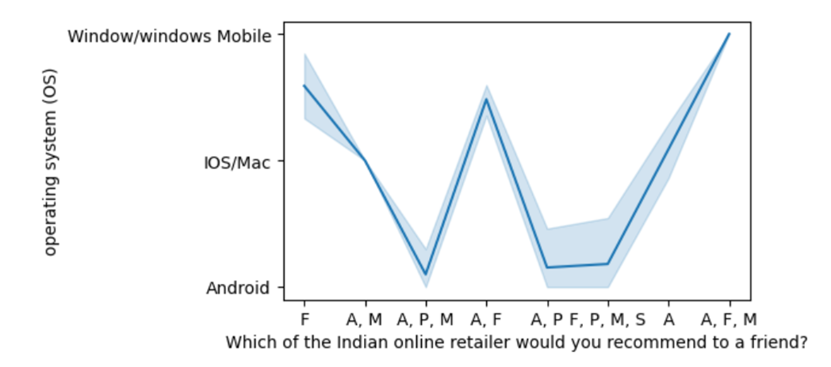
Preference of Respondents and the system quality

Slide 14
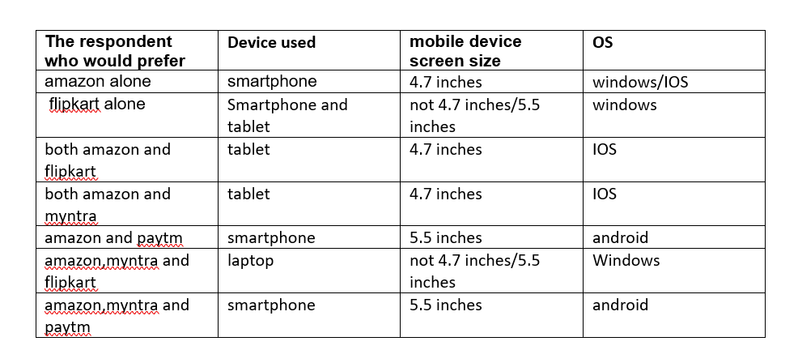

Slide 15
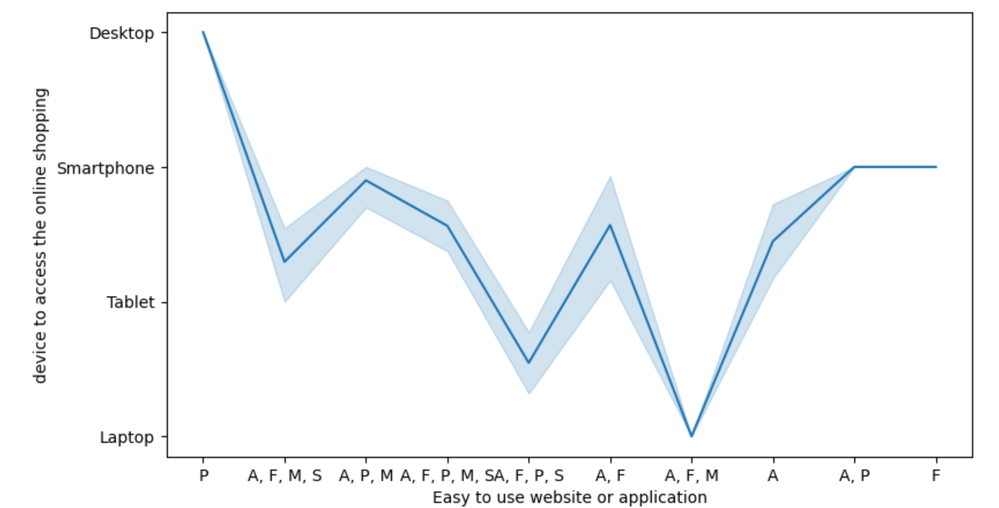
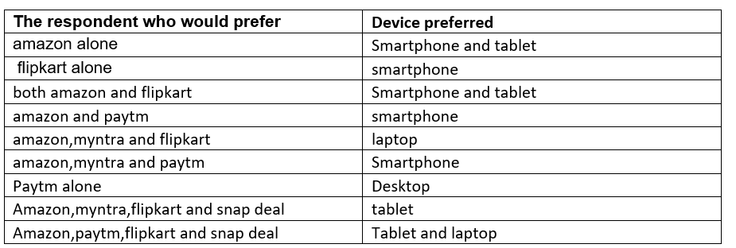
Easy to use websites and the device they used
This shows the device is most suited for the website

Slide 16
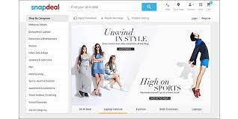
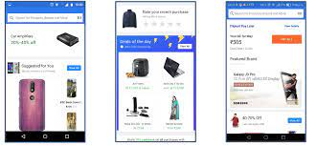
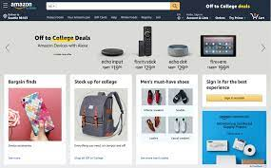
Information quality

Slide 17

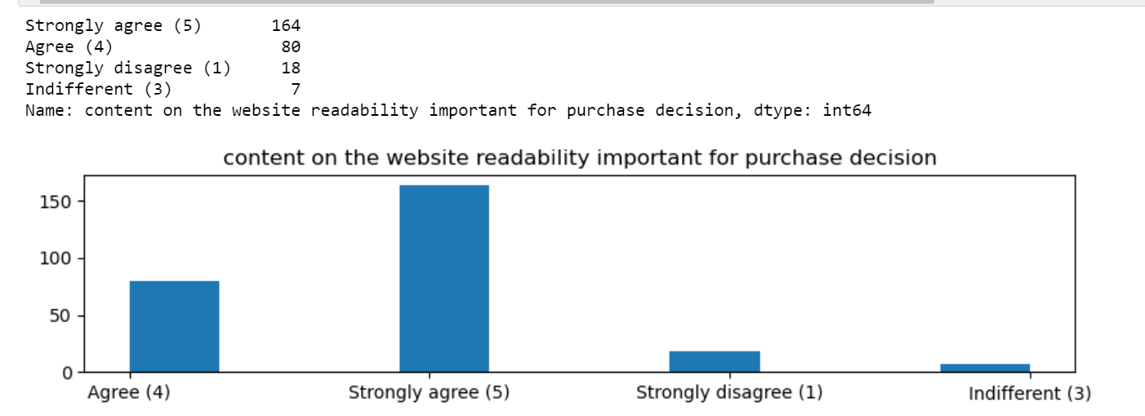
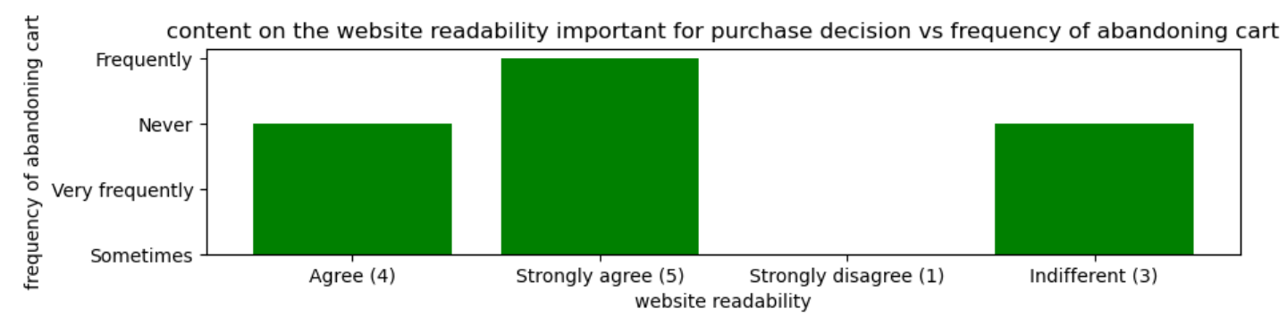
The readability of the product information is very significant as above 164 people have expressed how important it is to them. If not readable they are abandoning the bag

Slide 18
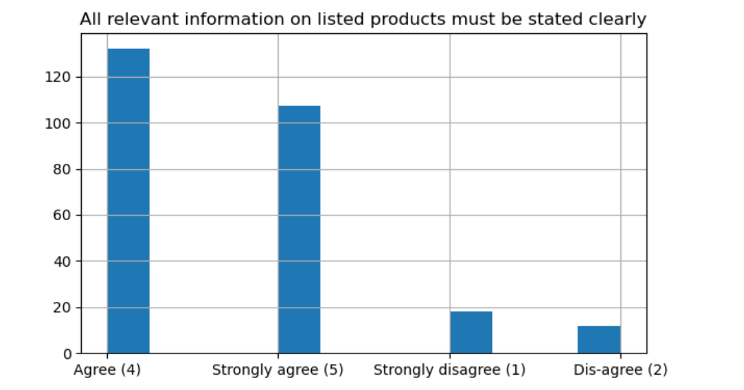
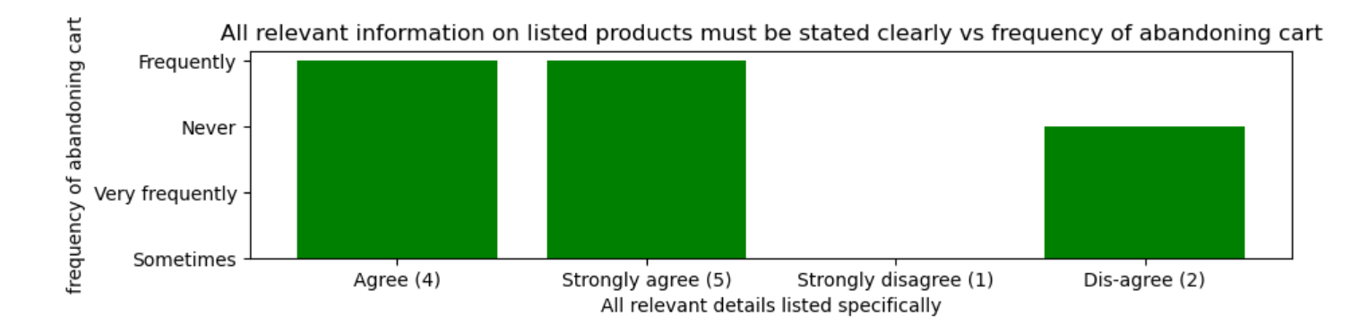
Clarity of content
The DETAILS of the product information is very significant as above 132 people have expressed how important it is to them.If details are not proper then they are abandoning the bag

Slide 19
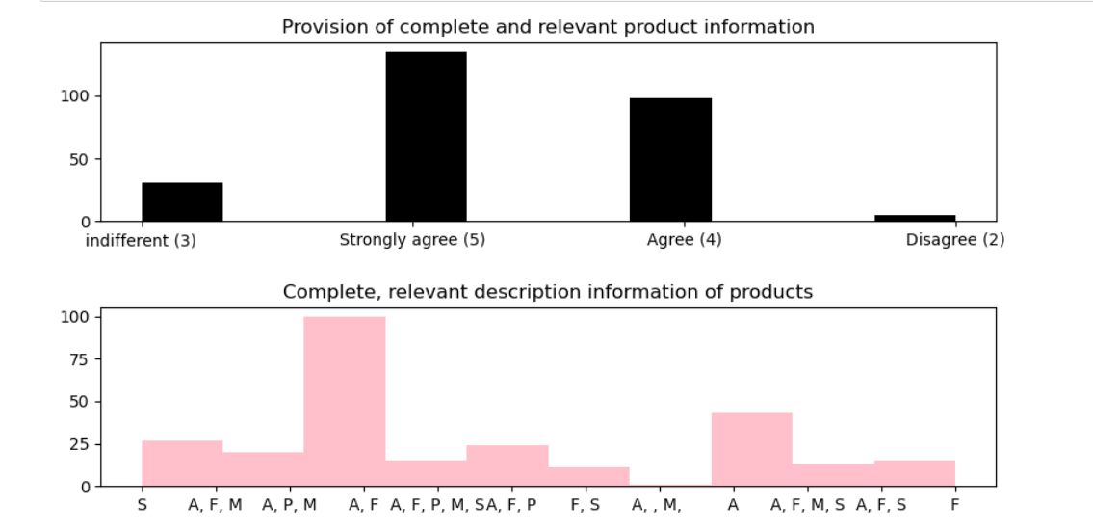
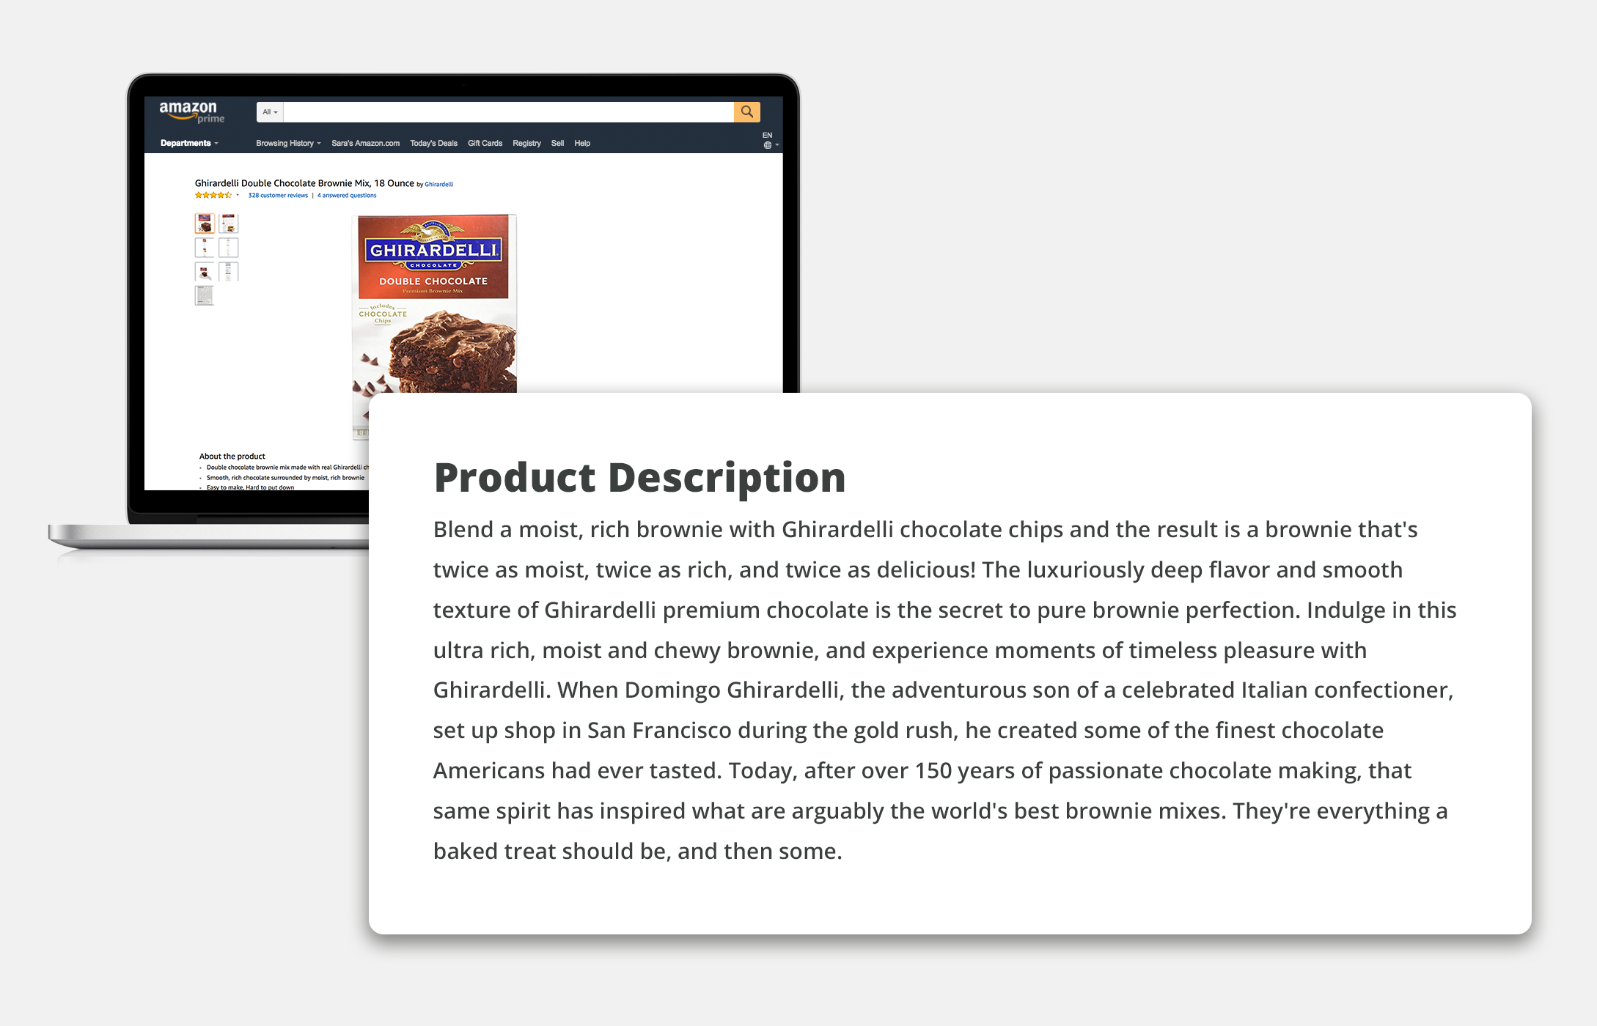
Complete, relevant description information of products websites/apps
The respondents strongly agree the significance of relevant product descrition With complete description, the user friendly interface is being impacted
Flipkart gives the best description and then Amazon.

Slide 20

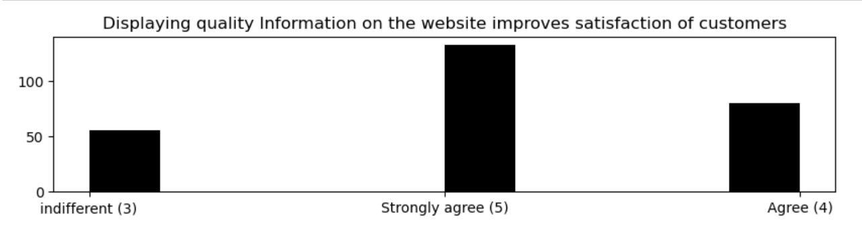
Relationship between product information and gratification
Displaying the quality of the product is very important for customer gratification

Slide 21
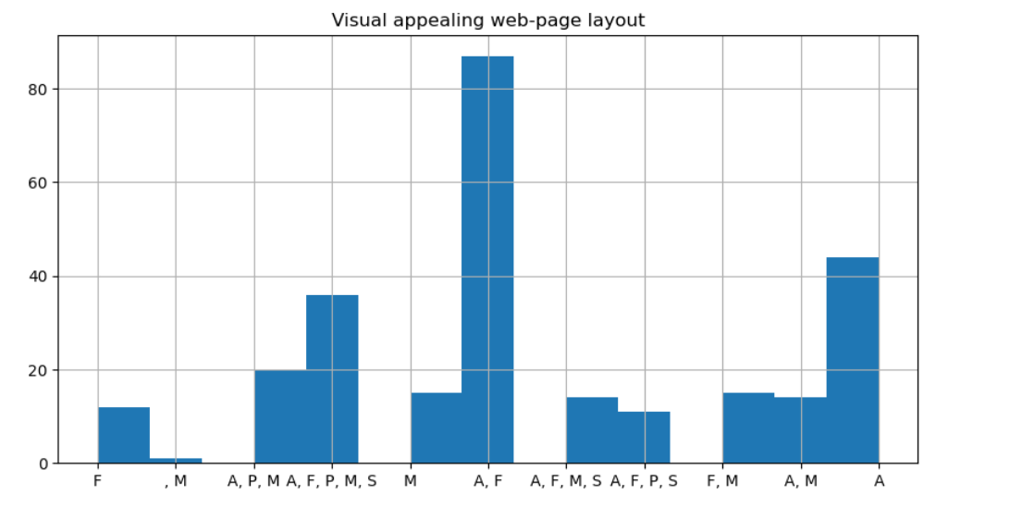
Visual appealing web-page layout
Amazon and flipkart are having the best visual layout
the visual appealing is impacting the User Friendly intercace of the website
it is not impacting much as a factor to be chosen again by the customer

Slide 22
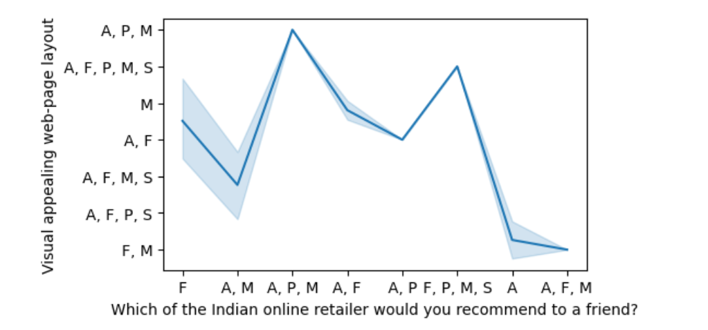
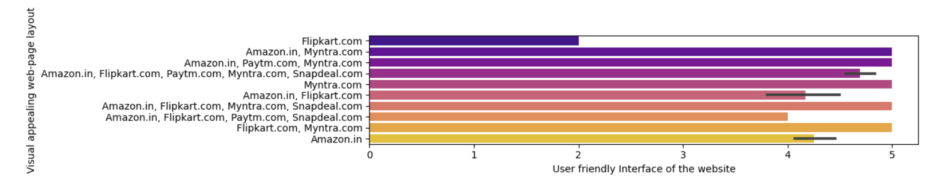
Visual appeal has less impact on recommendation to a friend

Slide 23


SERVICE QUALITY

Slide 24
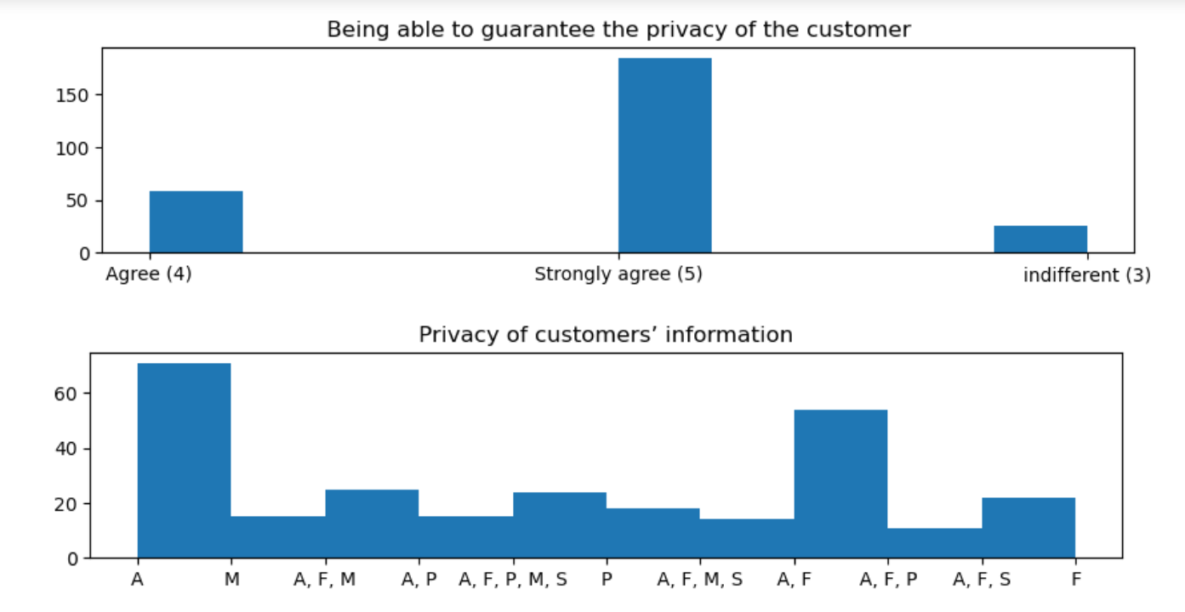
PRIVACY
It is very important for an individual to have privacy and the highest privacy of customer information is seen in amazon

Slide 25
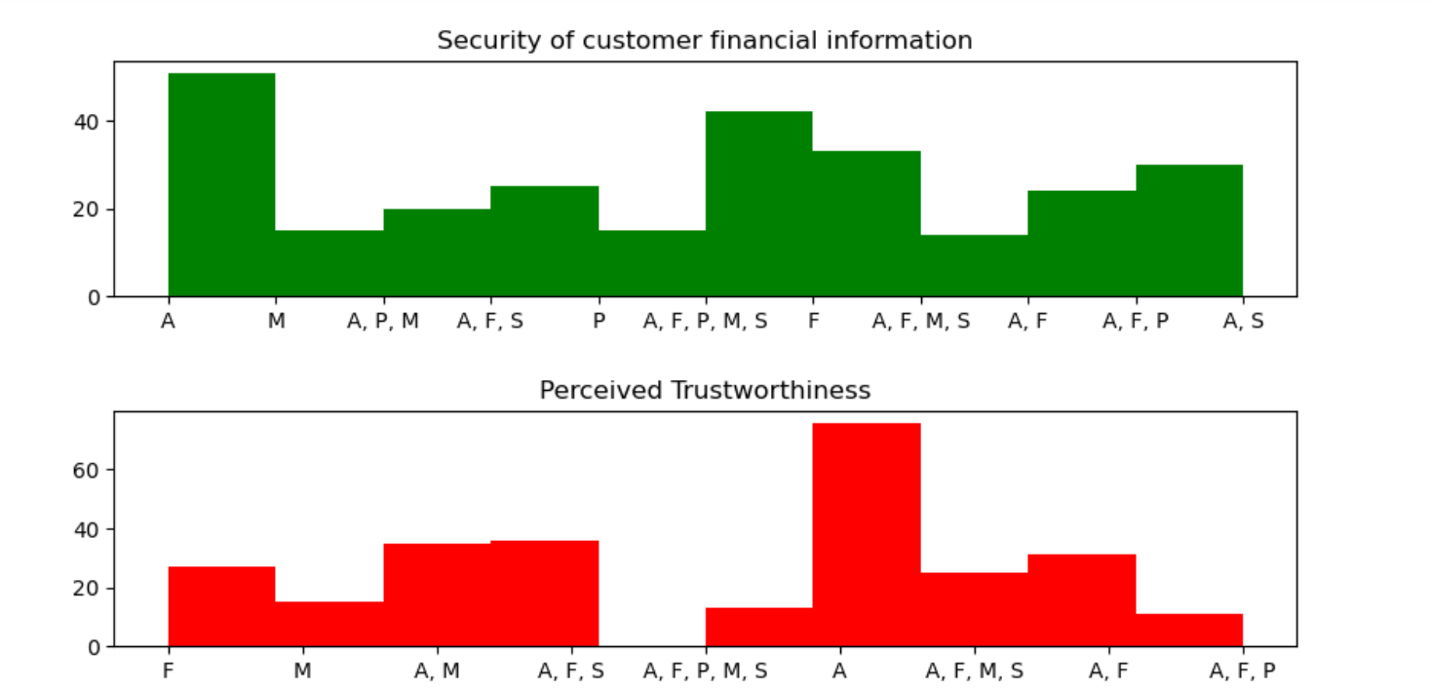
Highest privacy of customer financial information and perceived trustworthiness is also seen in amazon

Slide 26
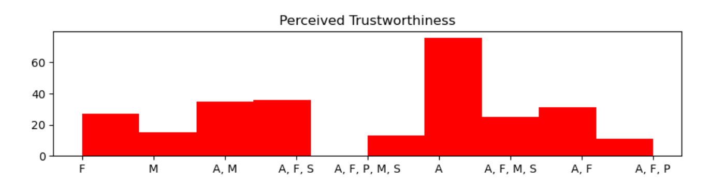
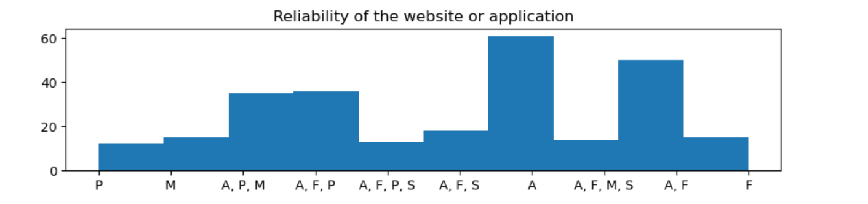
TRUST
Amazon is the most trust worthy

Slide 27
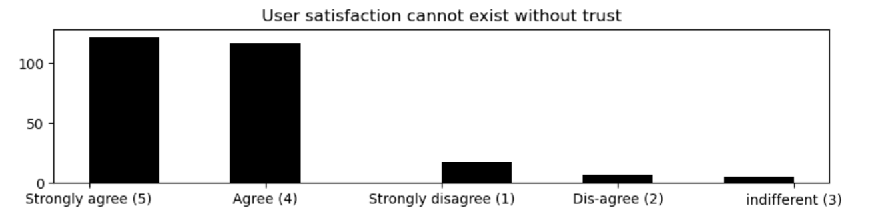
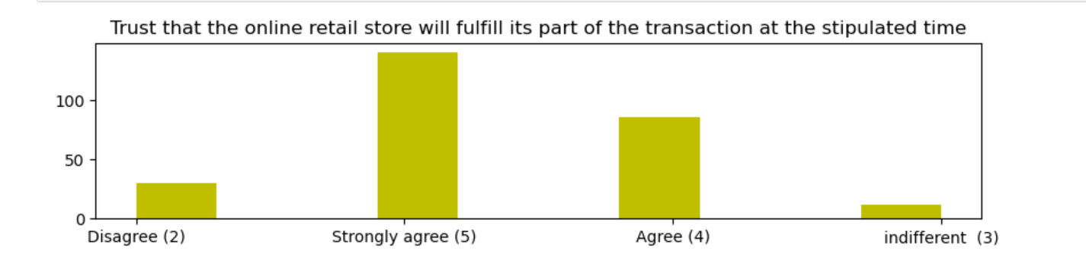
User satisfaction is directly proportional to trust that the product will be delivered in the proper amount of time

Slide 28

Monetary savings/Net benefit

Slide 29
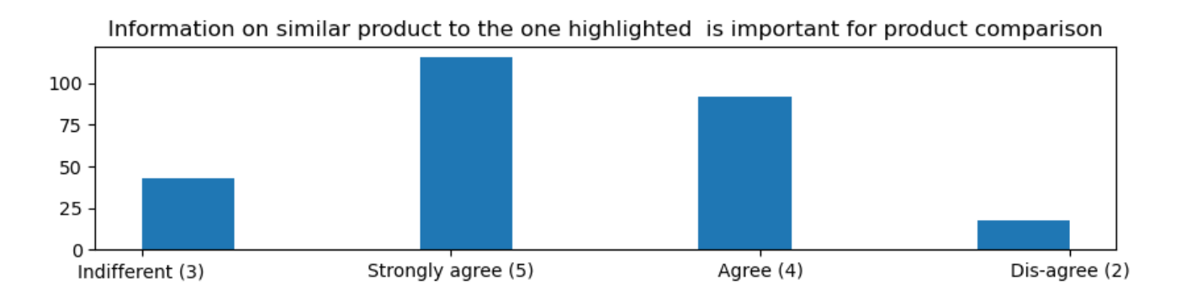
There is a wide proportion who does not need the product comparison and check net benefit

Slide 30
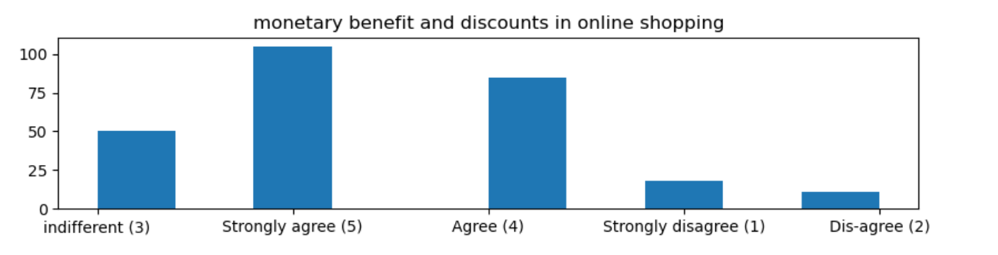

A large proportion of people is indifferent to the monetary benefits

Slide 31
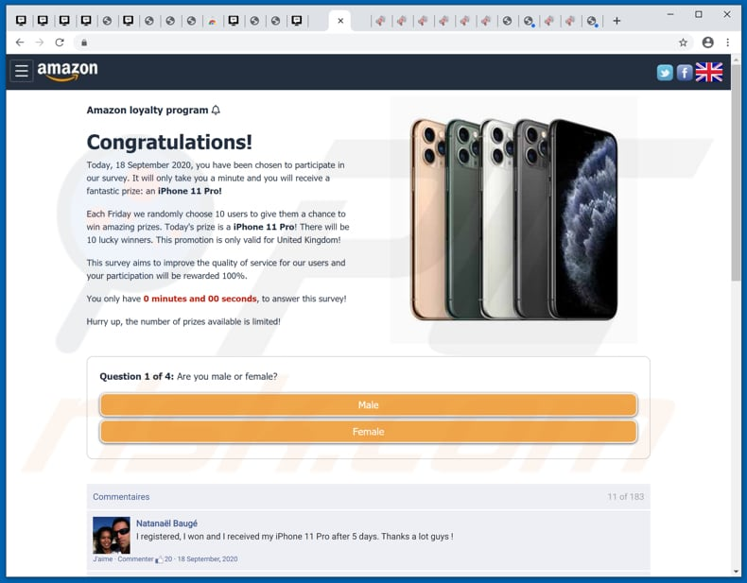
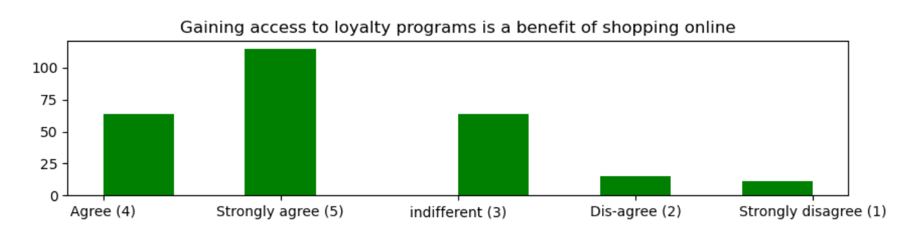
Access to loyalty programs
A large section is indifferent to loyalty programmes

Slide 32

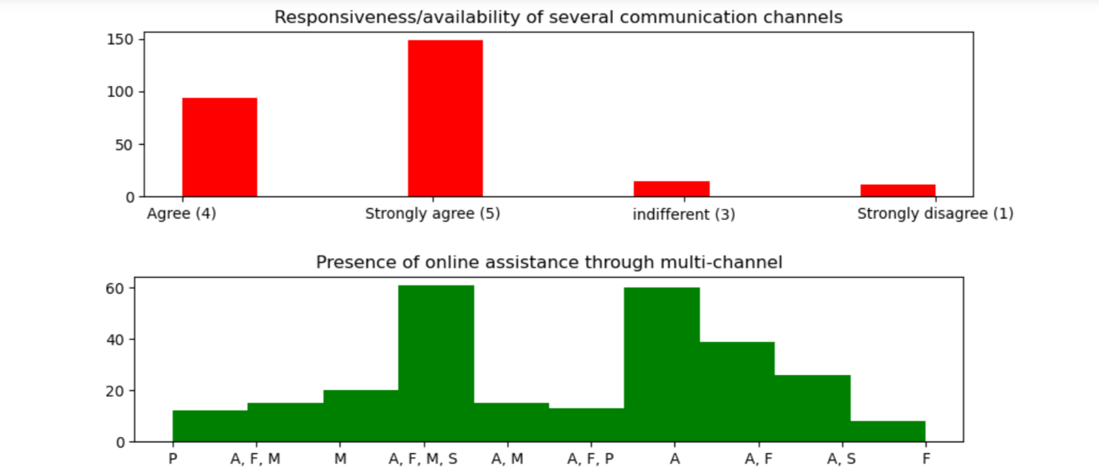
CUSTOMER CARE
Need for several communication channels:
There is a high need for several communication channels and Amazon is the best in online assistance through several communication channels

Slide 33

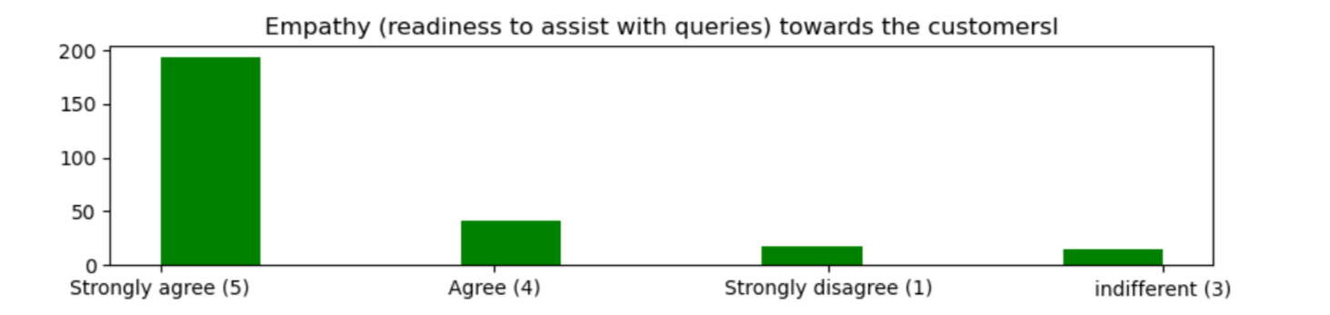
Empathy (readiness to assist with queries) towards the customers:

Slide 34
If Customer satisfaction increases, then these increases:
Purchase/customer activation
Repurchase Intention/CustomerReRetention
Customer Loyalty

Slide 35
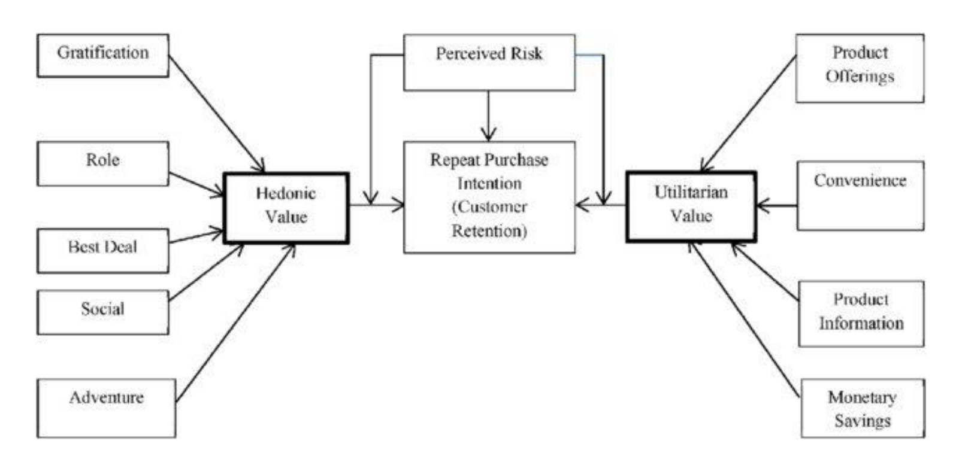

Slide 36
HEDONIC VALUE

Slide 37

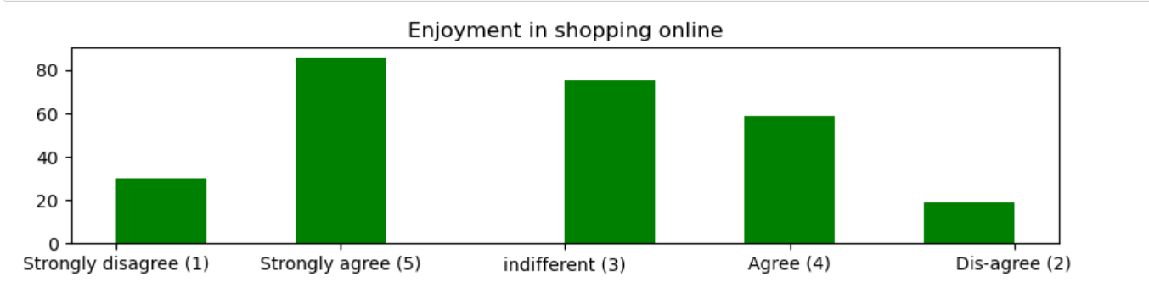
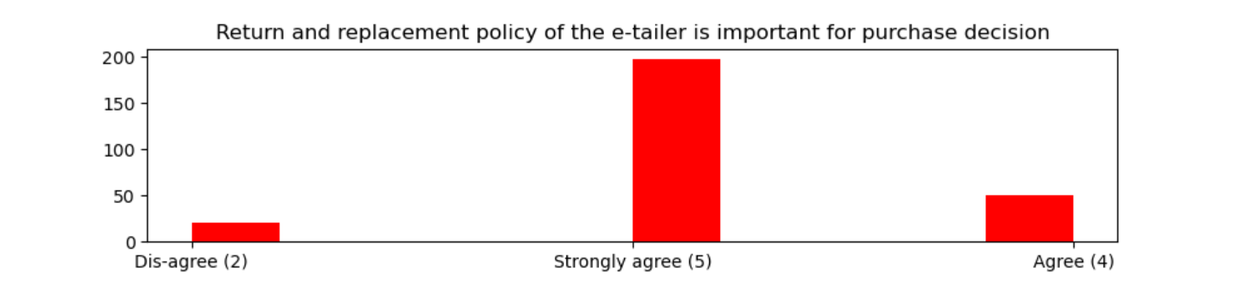
Gratification
There is a large section of respondents who are indifferent about shopping online and also many who strongly disagree that enjoyment is not present in shopping online
Return and replacement is very important for shopping online

Slide 38
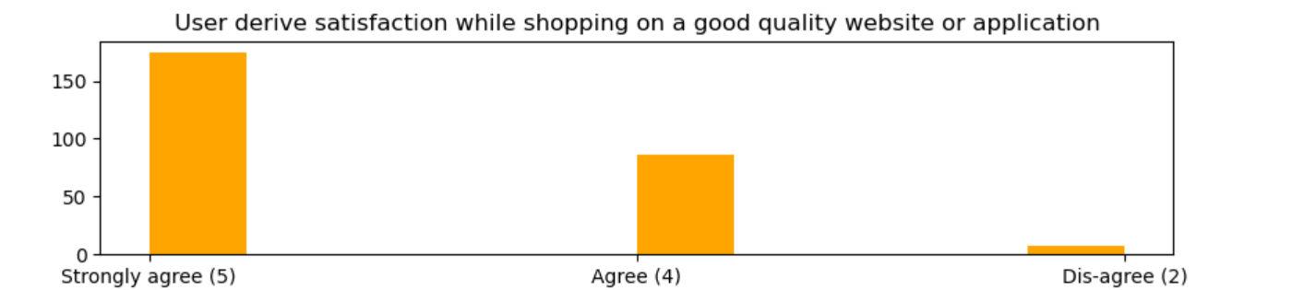
Customers derive satisfaction only when the website quality is good
Displaying the quality of the product is very important for customer gratification

Slide 39
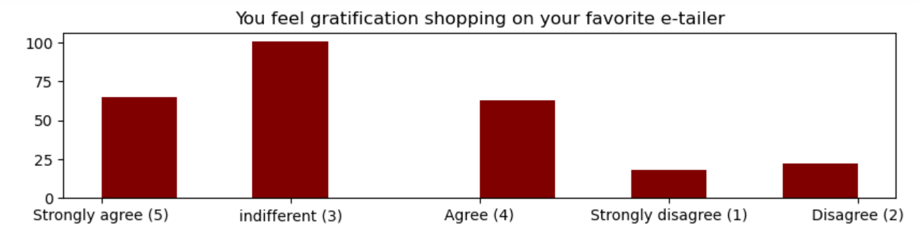

Mostly people dont get affected emotionally by which online store they buy from as they have no much attachment to it

Slide 40


Role

Slide 41




Best Deal
Wide variety of products to choose from is siginificant for taking decisions

Slide 42



Social
There is ease in patronizing a retailer

Slide 43


It is not an accepted idea among respondent,
That online shopping increases the social status
Most of the people are indifferent to it

Slide 44



Adventure
Eventhough some respondents respond they come into the website for adventure in some small sense. But There is also a large number of respondent were indifferent to it

Slide 45
UTILITARIAN VALUES

Slide 46

Product offers

Slide 47
CONVINENCE
User Friendliness of the the website
Ease of navigation in website
flexibility
Time taken to log in
Payment methods
Delivery speed

Slide 48


User Friendliness of the the website
the largest section of respondent strongly agree or agree that user friendly websites impacts in taking decisions
Amazon ,flipkart,paytm and myntra all are easy to use websites

Slide 49



Ease of navigation between pages, impacts the user friendliness of the website

Slide 50


Amazon takes most amount of time to get logged in due to promotions and sales
Loading speed of amazon is fastest

Slide 51


Longest time in displaying graphics and photos is amazon and flipkart
Prices are declared late the most is myntra

Slide 52

Flexibility in shopping online
Flexibility is very important factor for decision making

Slide 53


Payment methods

Slide 54

Amazon is the quickest for transactions

Slide 55

Delivery Speed
Delivery speed is highest for Amazon

Slide 56



Monetary savings/Net benefit
It is very significant to show similar products descriptions as more than 70% have agreed to it

Slide 57


Eventhough a large group of people are drawn towards online shopping through discounts and loyalty shopping, a large group of people are indifferent to it

Slide 58


Slide 59
Thankyou. Have a great day ahead.

